Slide 1
CZ 3003 Software Systems Analysis and Design
Presentation of Crisis Management System by team 8Pax

Slide 2
General Overview
The Crisis Management System(CMS) is designed with the intent to send out important information regarding hazardous incidents to the general public and relevant departments

Slide 3
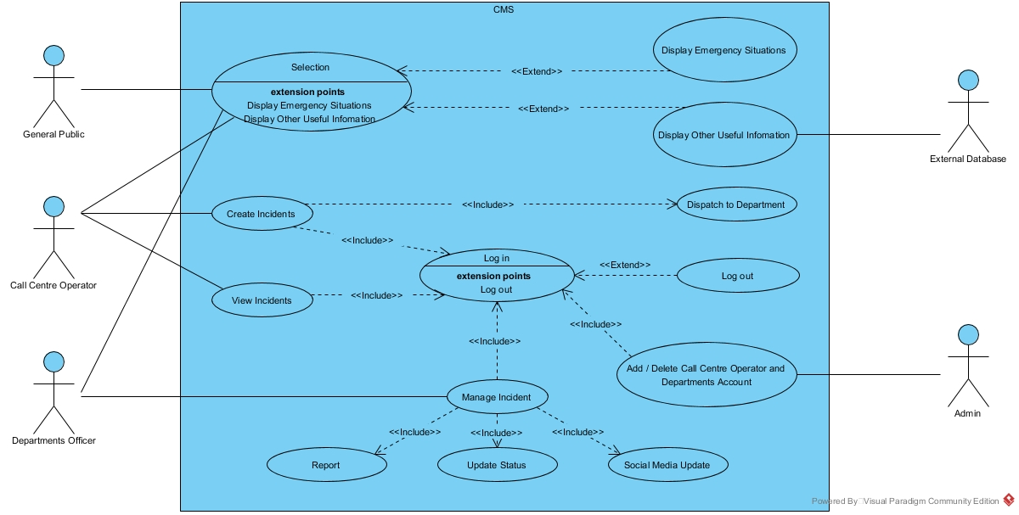
General Overview

Slide 4
What does the CMS do?
Users make reports regarding incidents that occur at their location i.e. fires, epidemic, accidents
Reports will be sent to the Call Centre and from there, the information is sent to the corresponding departments
Subscribers of the CMS social media, Mailing list will be notified about the updates on the incidents that are in their Area

Slide 5
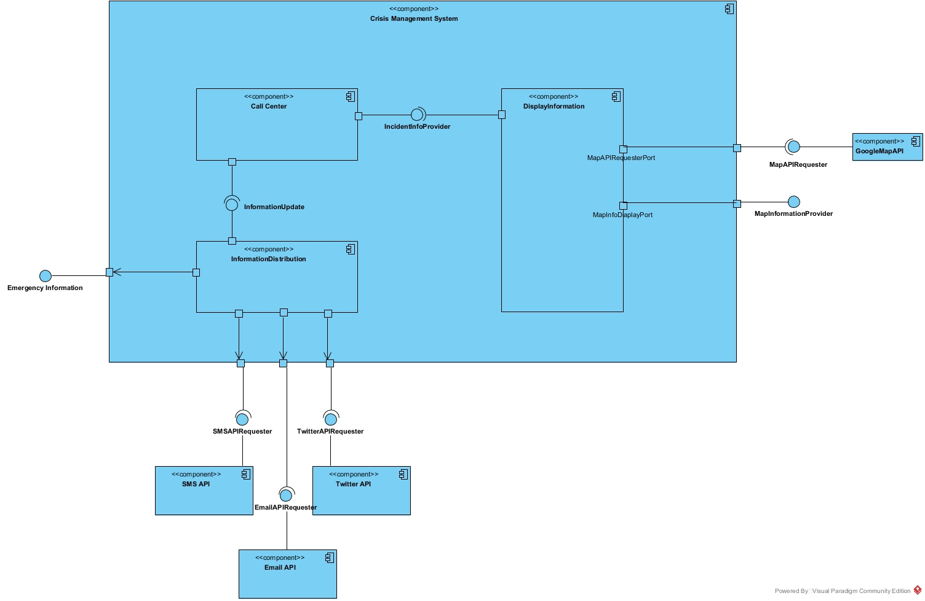
Overall CMS System

Slide 6
System Architecture
Consist of 3 subsystems
Information Display
Information Management(Call Centre)
Information Distribution

Slide 7
Subsystem 1: Information Display
Get the type of incident and location
Find the location using google maps API
Display it on a map on the website
Display useful information i.e. closest shelter
Display incident information

Slide 8
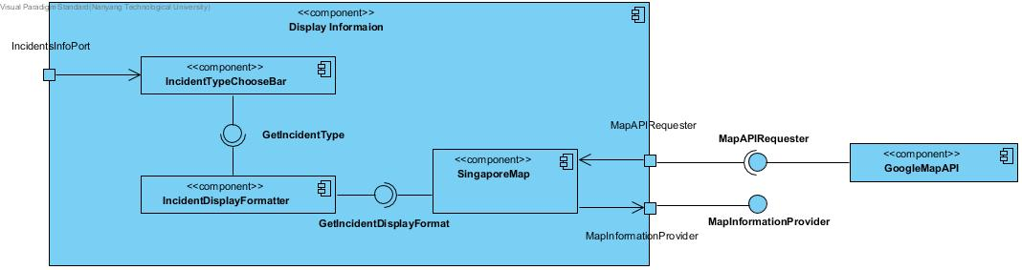
Subsystem 1: Information Display

Slide 9
Subsystem 2: Information Management
Allows the call centre operator to edit and change information regarding the incidents
Stores info of the reported incidents into a database
Allows Updates on the incident status, tracking of the incident status

Slide 10
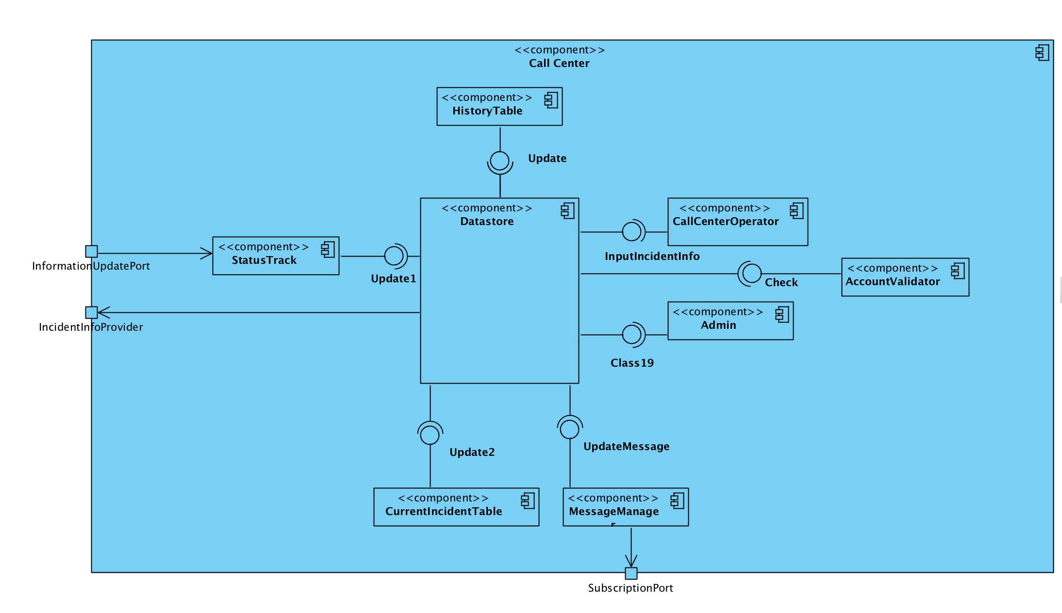
Subsystem 2: Information Management

Slide 11
Subsystem 3: Information Distribution
Takes Information of the incident from Call Centre
Sends the info to the corresponding departments
Generates a Status Report for High Ranking officials i.e. Prime Minister
Sends updates about incidents to subscribers via SMS, Email, Social Media

Slide 12
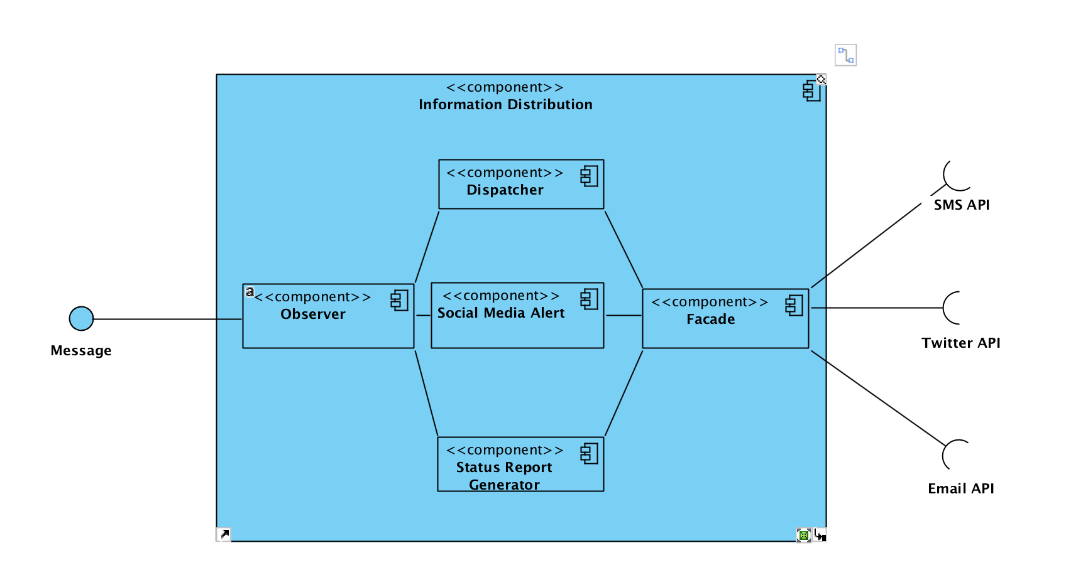
Subsystem 3: Information Distribution

